Slide 1
COMP 3617
Week 5

Slide 2
Agenda
Custom ListView Adapter (Contd…)
Pickers
Dialogs
Fragments (Will be continued next week)

Slide 3
Custom Adapter
Last week we saw the ArrayAdapter<String> that displays simple string information in a textview for each element of the list
To provide custom view for each item of the data in the underlying list, a custom adapter needs to be defined
Custom adapter extends from ArrayAdapter or BaseAdapter
Adapter needs to provide the layout for each row in the list, which is usually defined by a custom layout

Slide 4
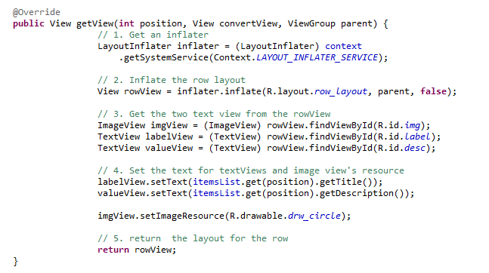
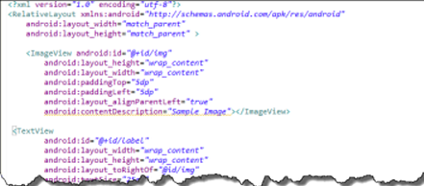
Custom Adapter
Custom Layout for each row

Slide 5
ViewHolder Pattern
Looking up the isolated views in the row template using the findViewById can hinder performance on a large list
To speed up a viewHolder object can be made use of to stash the component view references of the layout
ViewHolder object stores each of the components views inside the tag field of the row layout
For an example http://developer.android.com/training/improving-layouts/smooth-scrolling.html#ViewHolder

Slide 6
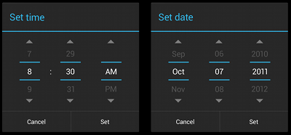
Pickers
Allows for picking a time or date
Reduce any structural validation checks
Instead of using the controls in a standalone manner, Android recommends using DialogFragment to wrap these controls

Slide 7
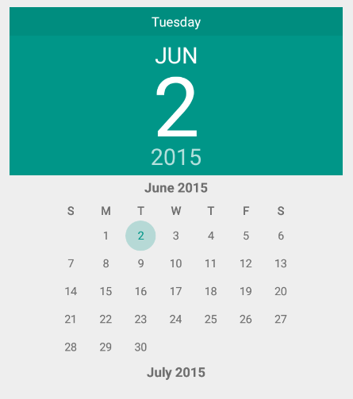
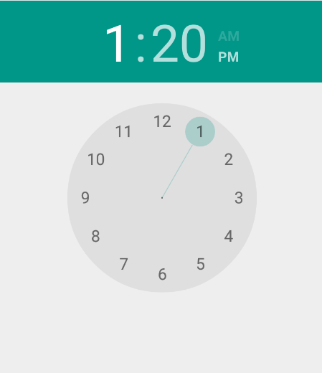
Pickers since Lollipop

Slide 8
Dialogs
Same concept as in desktop applications
Does not fill the entire screen
Used for display of modal events requiring the user to act on before proceeding
There is base class called Dialog that should not be directly used
AlertDialog is a subclass of Dialog
AlertDialog is used to display a title, up to three buttons and a list of selectable items
Other subclasses include DatePickerDialog and TimePickerDialog (buggy in previous versions)

Slide 9
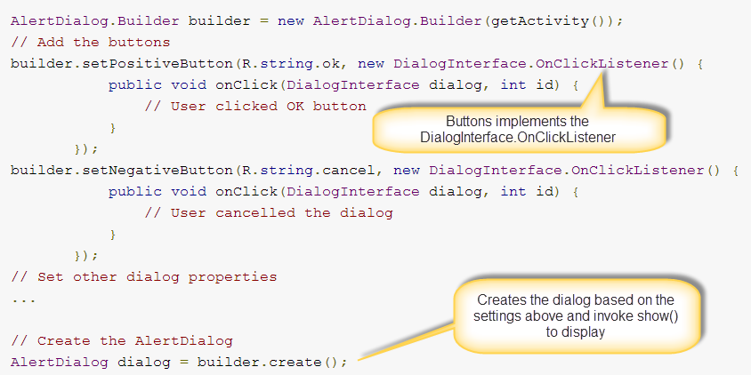
Alert Dialog
Uses a Builder pattern to build the dialog
For example to add two buttons :

Slide 10
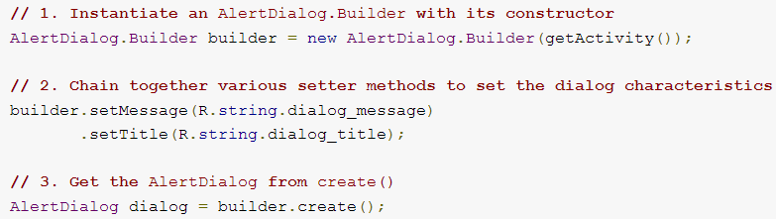
Alert Dialog Builder
Three steps to build the dialog with an Alert Dialog
Instantiate an AlertDialog.Builder with the constructor (constructor requires a context)
Chain the required setter methods to set the dialog characteristics and behavior
Get the AlertDialog via the create() method

Slide 11
Dialog with a List of items
Alert Dialog can be used to display a list of items
Use setItems() method of the alert dialog to display a list of choices
setItems() and setMessage() methods are mutually exclusive
Alert Dialog Builder is versatile to even display a custom dialog created via a layout

Slide 12
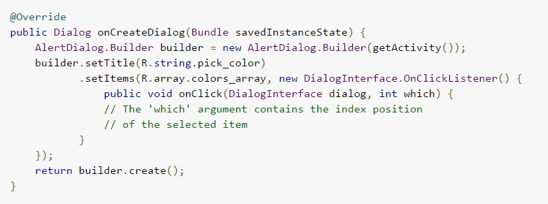
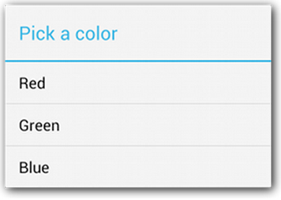
Dialog with a List of items

Slide 13
Fragments
Class the define part of screen or user interface
An activity can display one or more fragments
Fragment can be reused in multiple activities
Introduced in Android 3.0 and then back ported via the support library
Android platform itself does not really know about fragments unlike activities, which it manages

Slide 14
Fragments
Must be embedded in activities. Cannot have a life of their own
Fragment typically has a separate layout file

Slide 15
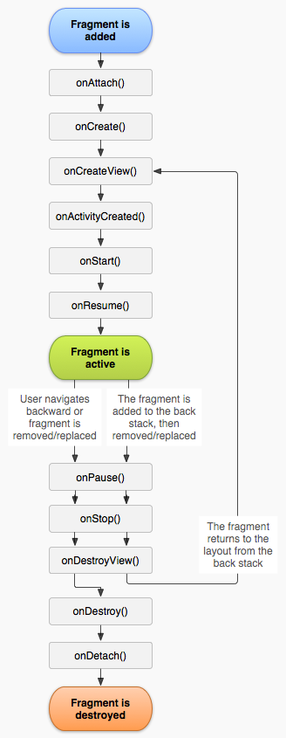
Lifecycle of a Fragment
Fragment has a lifecycle similar to an activity, but not identical
More callback methods in a fragment
Fragment and activity lifecycle methods interleave
You can check it out for yourself by overriding the methods and logging

Slide 16
Lifecycle of a Fragment
Fragment Method | Description
onAttach() | Called when the fragment is first attached to a specific activity
onCreate() | Initial creation of the fragment
onCreateView() | Called when the view hierarchy for the fragment should be created
onActivityCreated() | Informs the fragment that its parent activity’s onCreate() has completed
onStart() | Fragment’s user interface visible, but not active
onResume() | Fragment’s user interface is active for interaction
onDestroyView() | Clean up any user interface layout
onDestroy() | Clean up resources associated with the Fragment
onDetach() | Called before the fragment is detached from the activity
Notes:
Not all callback methods of the fragment are listed here

Slide 17
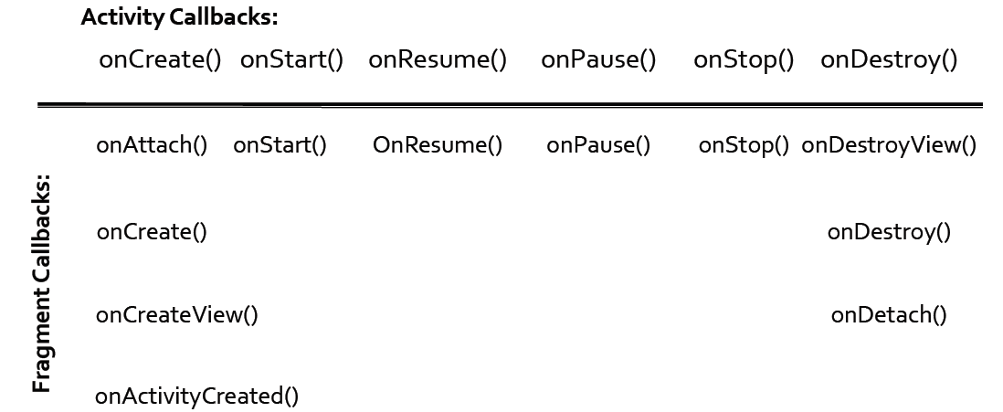
Activity & Fragment Lifecycle

Slide 18
Important Methods of Fragment
onCreate() is where you do any set up that does not require the activity to be fully created
onCreateView() is where the fragment sets up the view
onCreateView() is where you get references to views on the fragment layout as well
onActivityCreated() is used for any set up that should take place after the Activity’s onCreate has been called

Slide 19
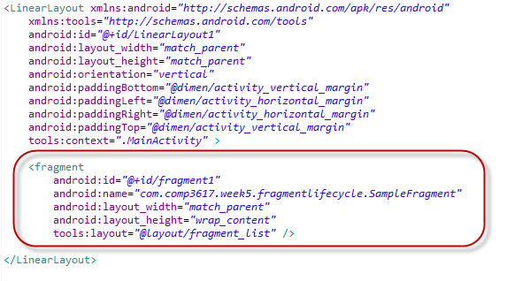
Adding a Fragment to an Activity
There are two ways to add a fragment to an activity – dynamically and statically
Statically embedding a fragment means you embed the fragment in the activity’s layout

Slide 20
Adding a Fragment to an Activity
Dynamically adding a fragment means you add the fragment in code to the activity layout
You make use of a class called FragmentManager which is available on Activity (from Android 3.0 and above)
Fragment Manager provides a reference to a transaction with which you can manipulate the fragments
You can add, replace and remove fragments from an activity

Slide 21
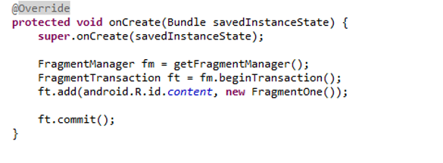
Dynamically adding a Fragment to an Activity

Slide 22
Passing Arguments to Fragments
Sometimes you want to pass arguments to the fragments when they are created
You cannot use the constructor to do so as the fragment must have only a default constructor
To get around this a common pattern is to create a static newInstance() method for creating a Fragment with arguments
In the newInstance method use setArguments() call to pass in the parameters as a Bundle

Slide 23
Passing Arguments to Fragments
The passed in arguments can be retrieved in any of the fragment lifecycle methods via a call to getArguments();

Slide 24
Activity calling a Fragment Method
Sometimes an activity needs the fragment to perform a specific action
One way to do this is to let the activity invoke a public method exposed on the fragment
To get a reference to a specific fragment on the activity, you can call getFragmentById() on the FragmentManager

Slide 25
Dialog Fragment
Fragments can also be used to display dialogs
Implements all the basic functionality required for dialogs
Allows for reusability
Can be used in conjunction with AlertDialog.Builder or a custom layout
When used with AlertDialog.Builder, override the onCreateDialog and inside that method build the dialog and return it

Slide 26
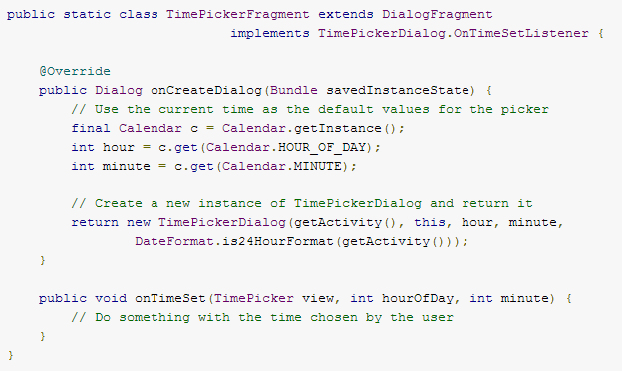
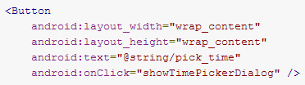

Time Picker Dialog

Slide 27
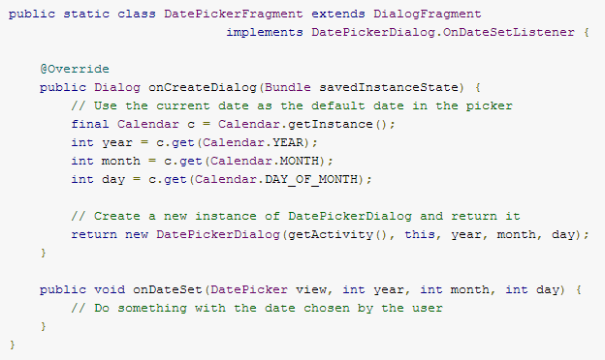
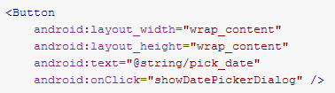

DatePicker Dialog

